Slide 1
IT 140 Design Presentation Template
Tiffany Sill

Slide 2

Storyboard: Description
You are a witch, living in your cozy secluded home in the forest. You’ve noticed some strange happenings in the forest around you, missing animals, strange human-sounding owl calls, and stolen greenhouse plants. You suspect that you are being stalked by La Lucheza, an owl/witch cryptid intent on stealing your life force. You must gather ingredients for your potion to strip her of her powers and usher her away. You will need your Grimoire, located in the library, for the spell needed, Crystals, located in the Study, for protection, and your Cauldron, located in the Kitchen, to create your potion. You will also need the ingredients for your potion. In your Apothecary Cabinet, you will find Potion Oil. In your Menagerie, you will find an Owl Feather. In the greenhouse, you will find the Herbs need to complete the potion. La Lucheza, is outside the greenhouse, waiting for you. Good luck and blessed be.
Jessica Lauser [jlauser.art]. (October 16, 2021). “Day 16: La Lechuza In Mexican folklore, the legend of La Lechuza tells of a shapeshifting witch who transforms herself into a monstrous owl” [Photo]. Instagram. https://www.instagram.com/p/CVGwBFErstR/

Slide 3
Storyboard: Map
East
Outside
La Lechuza (Cryptid)
Greenhouse
Item: Herbs
West
North
South
Apothecary Cabinet
Potion Oil
Living room
Menagerie
Item: Owl Feather
East
North
South
West
East
Kitchen
Item: Cauldron
West
North
South
East
Study
Item: Crystals
Library
Item: Grimoire
West

Slide 4
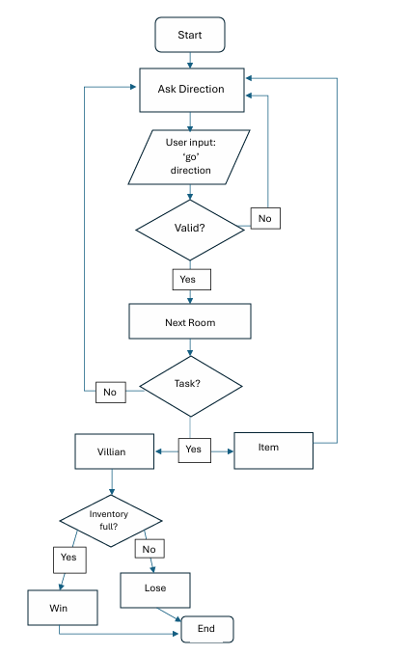
Flowchart: Move Between Rooms

Slide 5
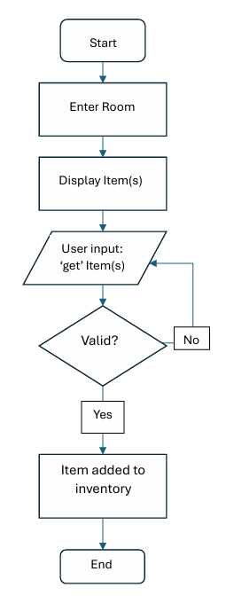
Flowchart: Get an Item

